Slide 1
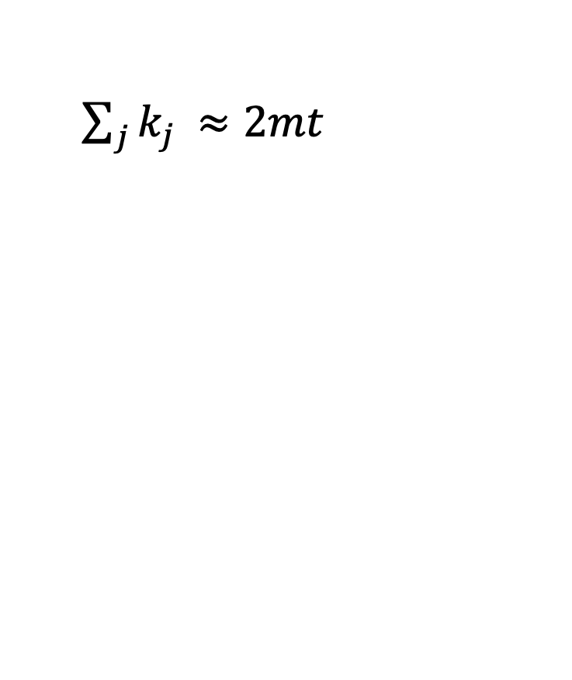
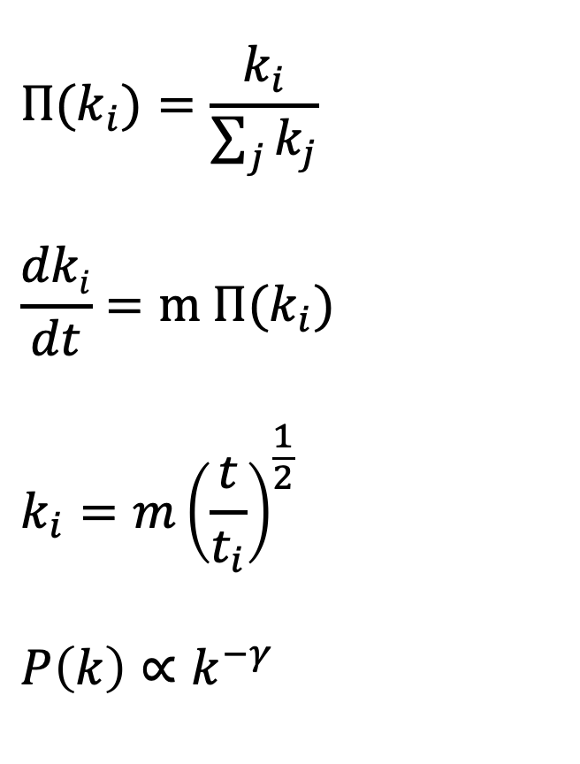
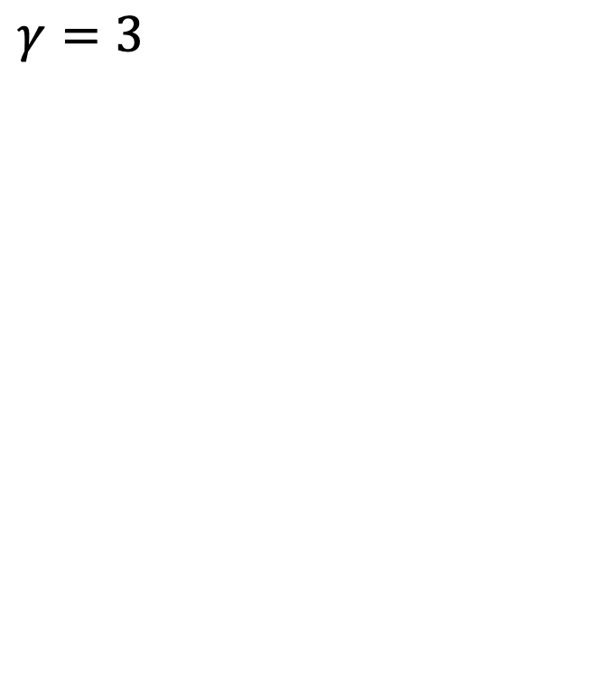
Theoretical overview: Barabasi-Albert
$${Π(k}_{i})=\frac{k_{i}}{\sum_{j}{k_{j}}}$$
$$\frac{dki}{dt}=m {Π(k}_{i})$$
$$k_{i}={m\left(\frac{t}{t_{i}}\right)}^{\frac{1}{2}}$$
$$P\left(k\right)∝k^{−γ}$$
$\sum_{j}{k_{j }≈2mt}$
$γ=3$

Slide 2
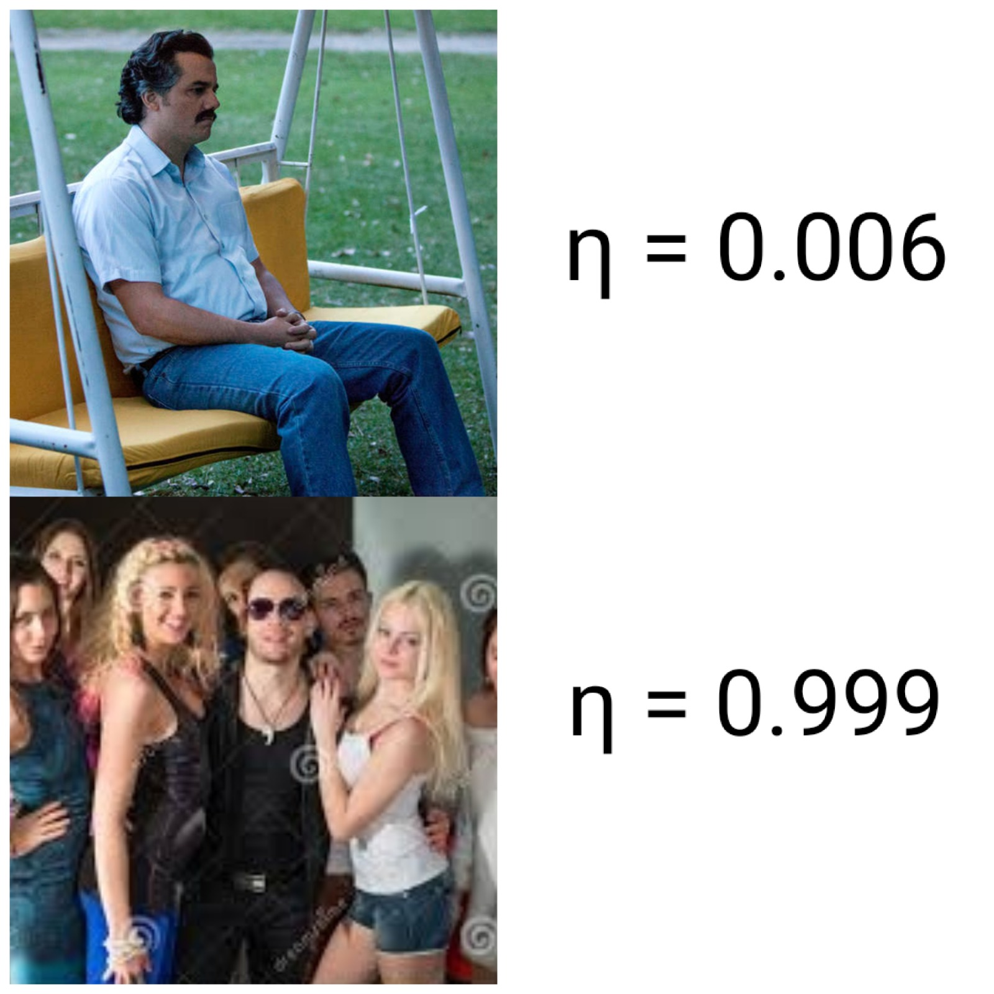
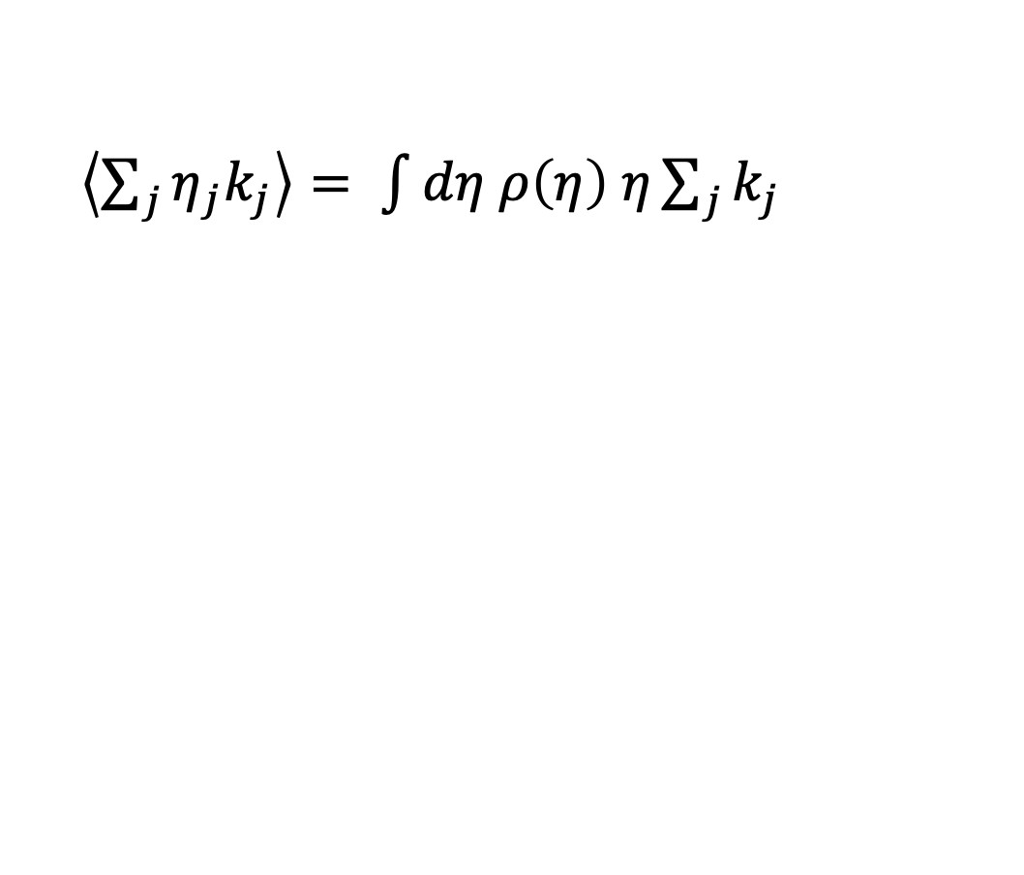
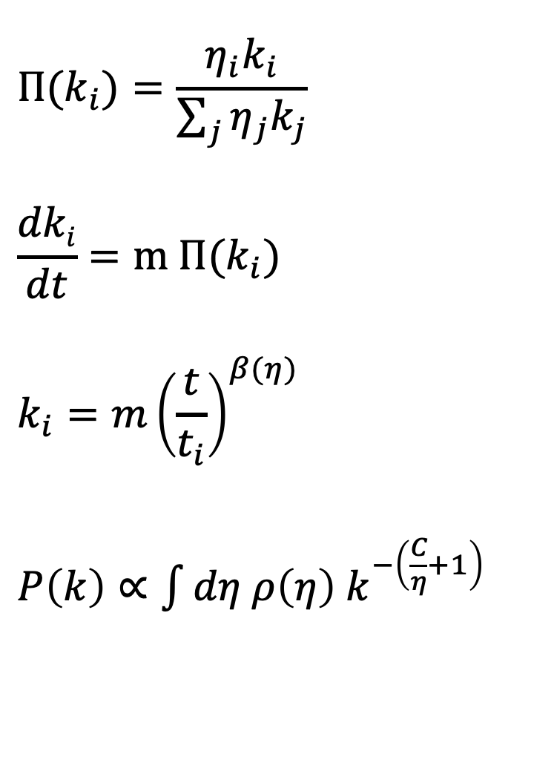
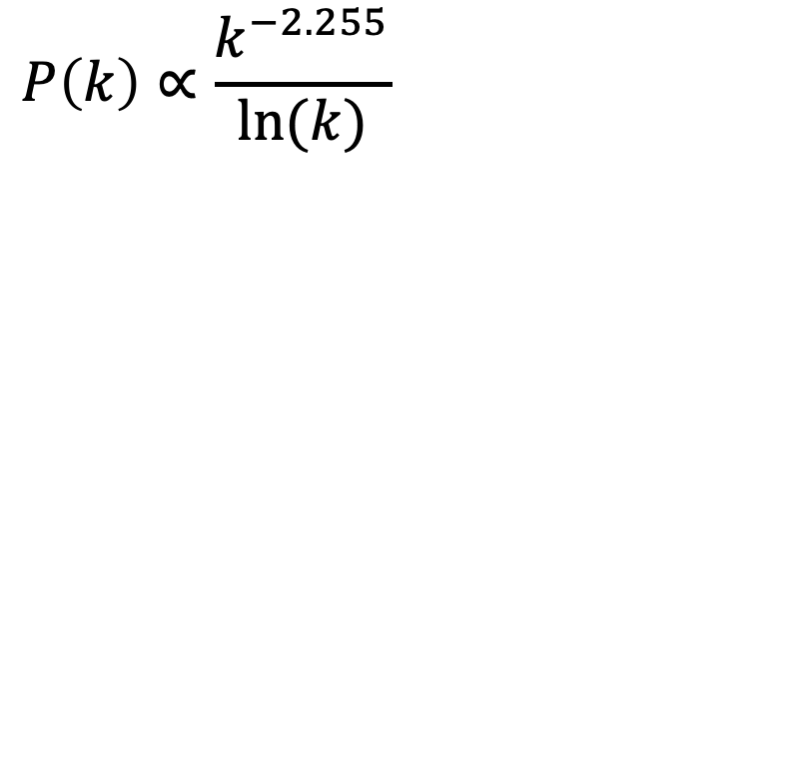
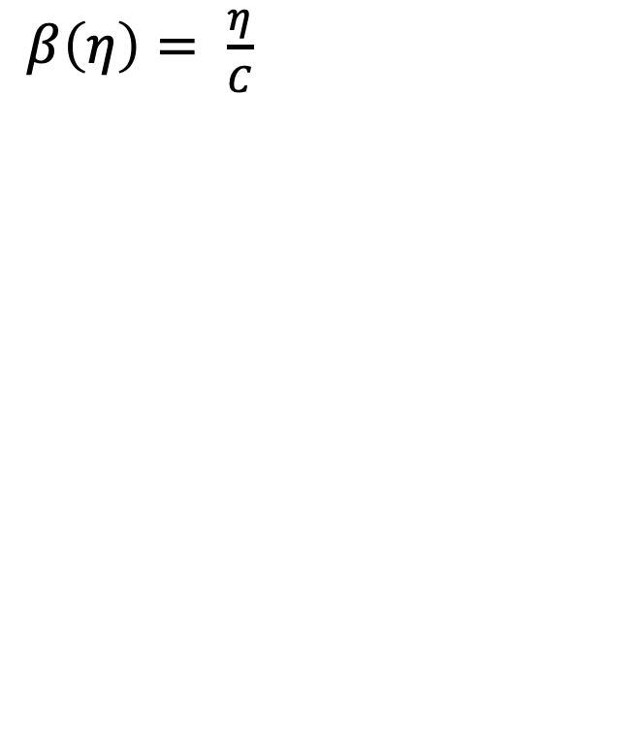
Theoretical overview: Bianconi-Barabasi
$${Π(k}_{i})=\frac{η_{i}k_{i}}{\sum_{j}{η_{j}k_{j}}}$$
$$\frac{dki}{dt}=m {Π(k}_{i})$$
$$k_{i}={m\left(\frac{t}{t_{i}}\right)}^{β(η)}$$
$P\left(k\right)∝\int{dη ρ\left(η\right) k^{−\left(\frac{C}{η}+1\right)}}$
$\left\langle \sum_{j}{η_{j}k_{j}}\right\rangle = \int{dη ρ\left(η\right) η\sum_{j}{k_{j}}}$
$β\left(η\right)= \frac{η}{C}$
$$P\left(k\right)∝\frac{k^{−2.255}}{ln⁡(k)}$$

Slide 3
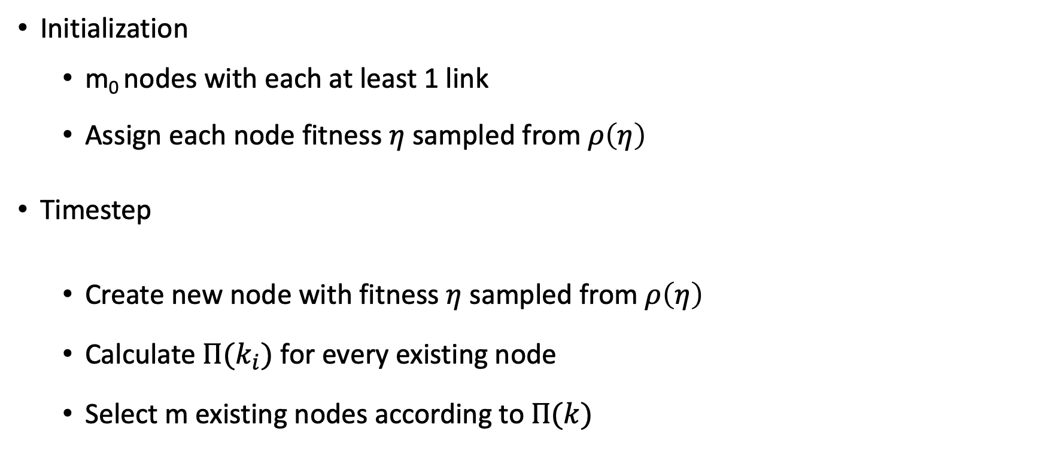
Model implementation
Initialization
m₀ nodes with each at least 1 link
Assign each node fitness $η$ sampled from $ρ\left(η\right)$
Timestep
Create new node with fitness $η$ sampled from $ρ\left(η\right)$
Calculate ${Π(k}_{i})$ for every existing node
Select m existing nodes according to$Π(k)$

Slide 4
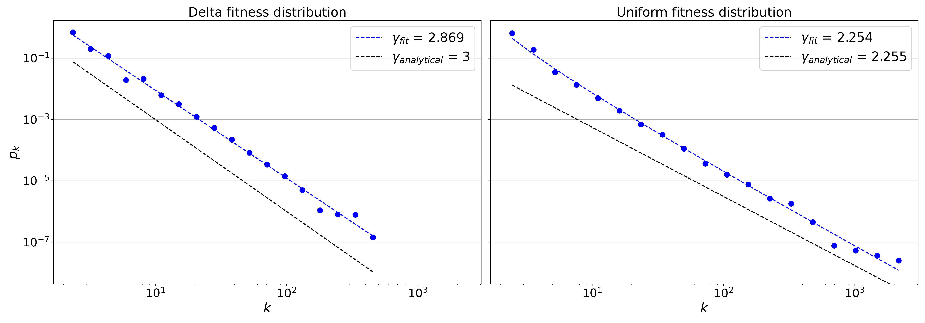
Analysis: Degree distributions

Slide 5
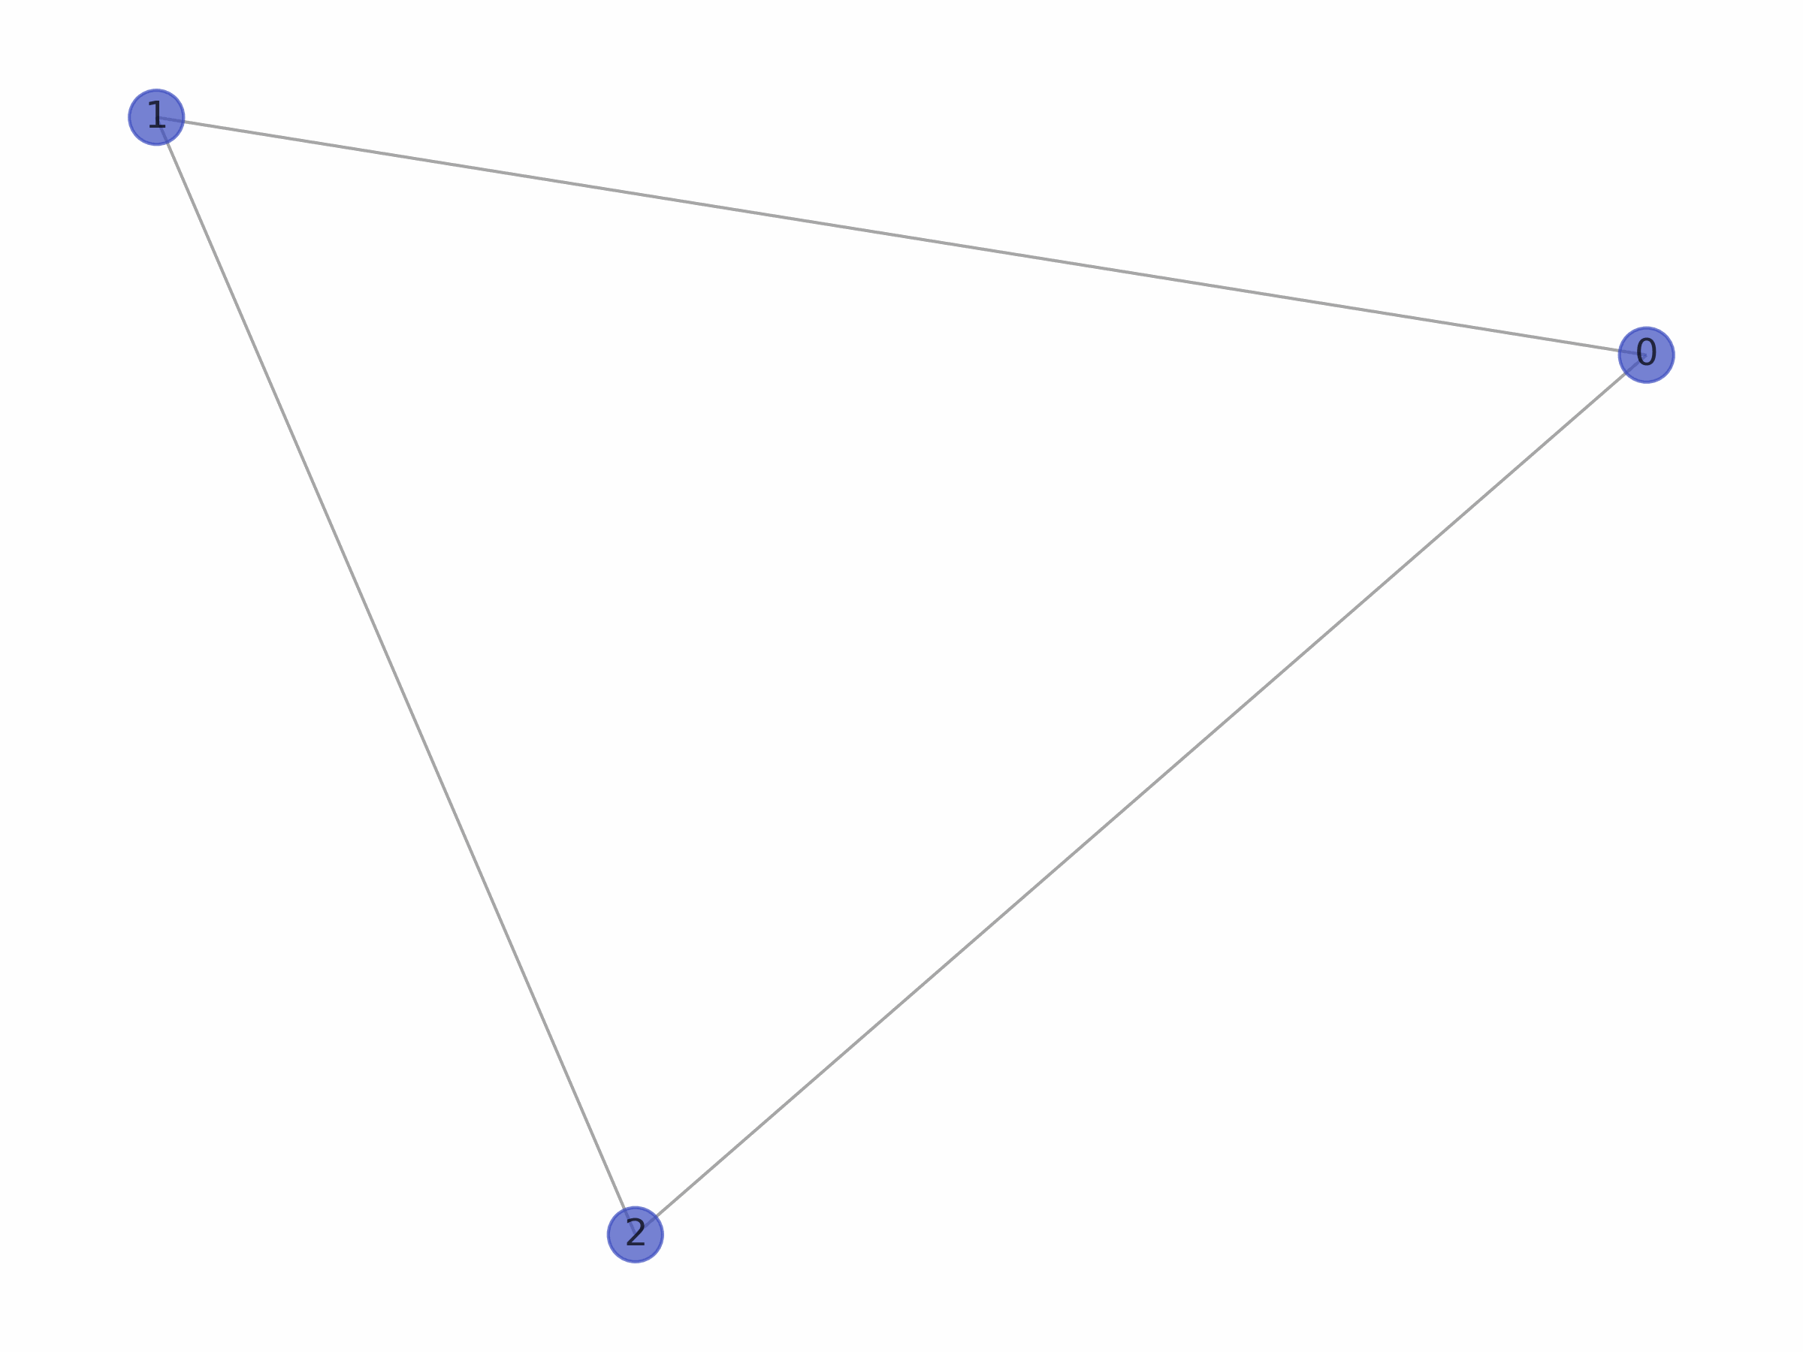
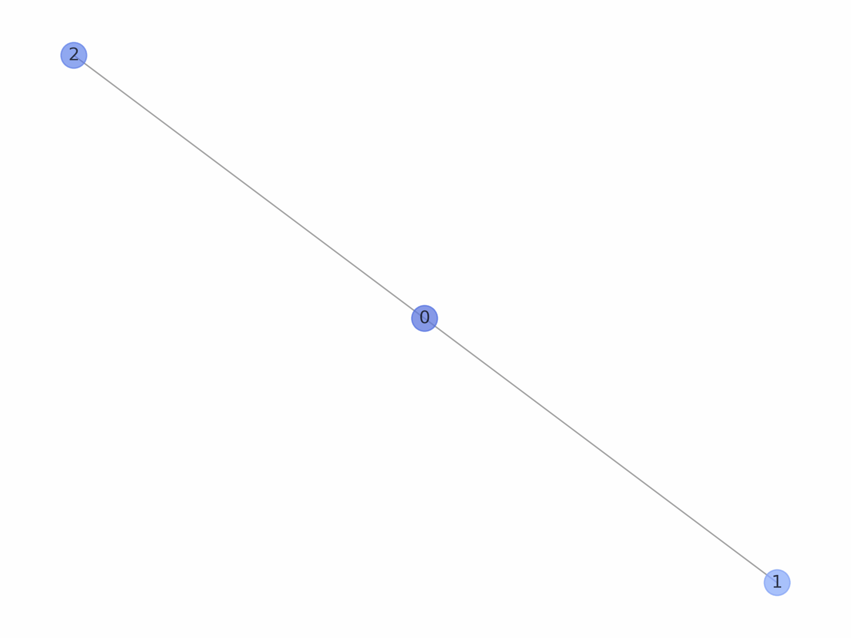
Analysis: Network visualization
Delta fitness distribution
Uniform fitness distribution

Slide 6
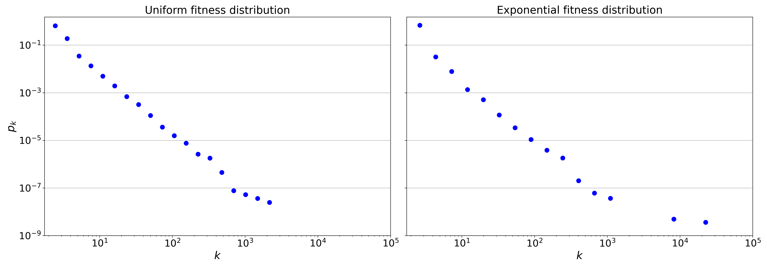
Analysis: Degree distributions

Slide 7
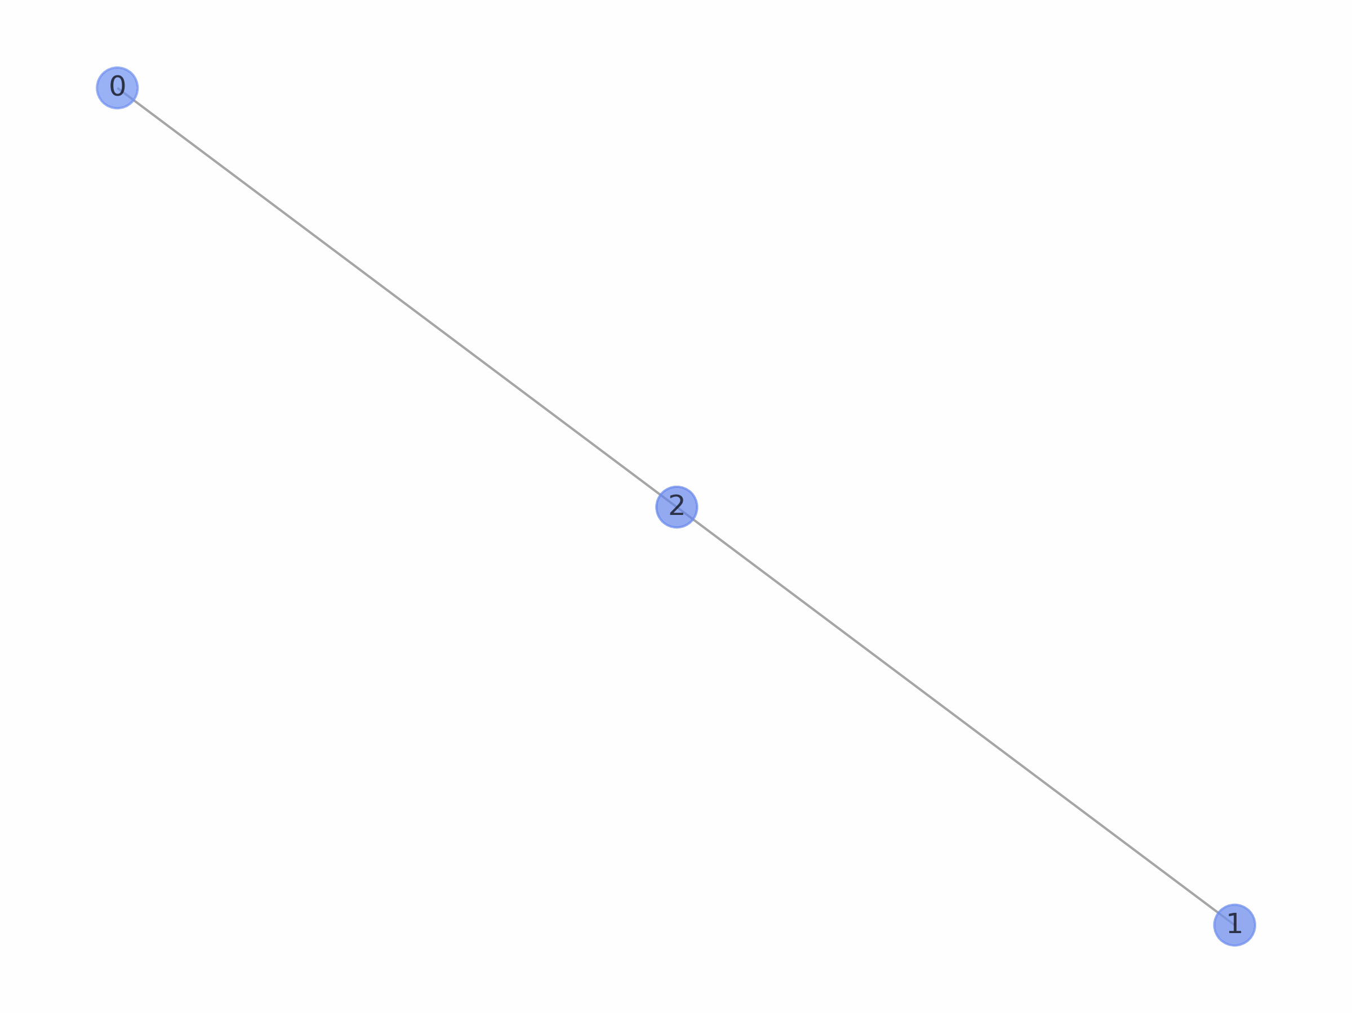
Analysis: Network visualization
Uniform fitness distribution
Exponential fitness distribution

Slide 8
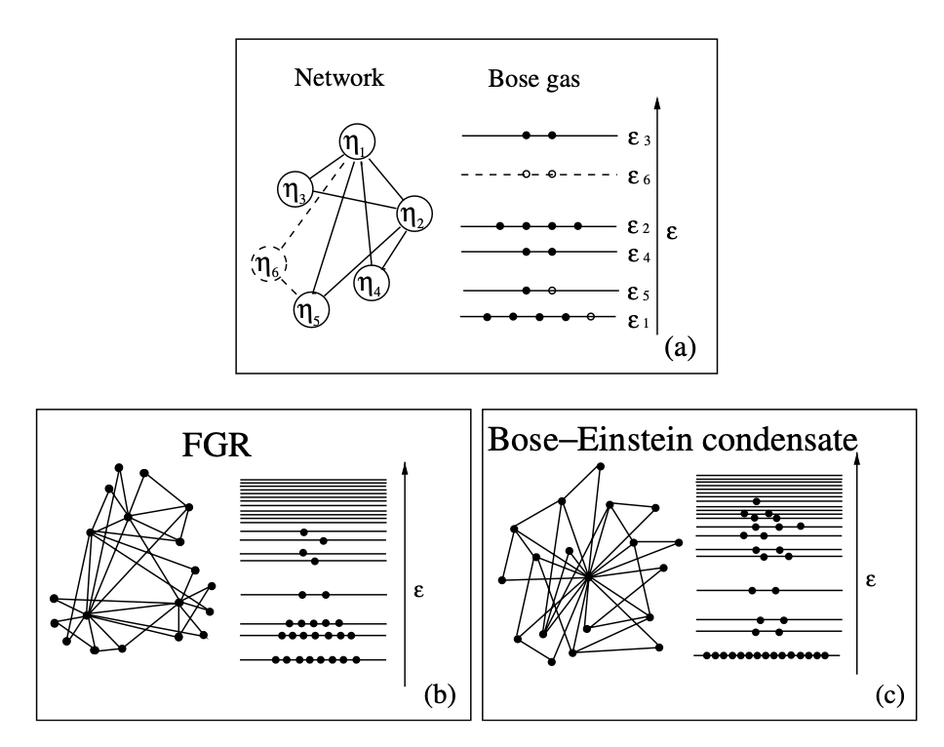
Phase transition: Bose-Einstein condensation
Bianconi, G., & Barabási, A. L. (2001). Bose-Einstein condensation in complex networks. Physical review letters, 86(24), 5632.

Slide 9
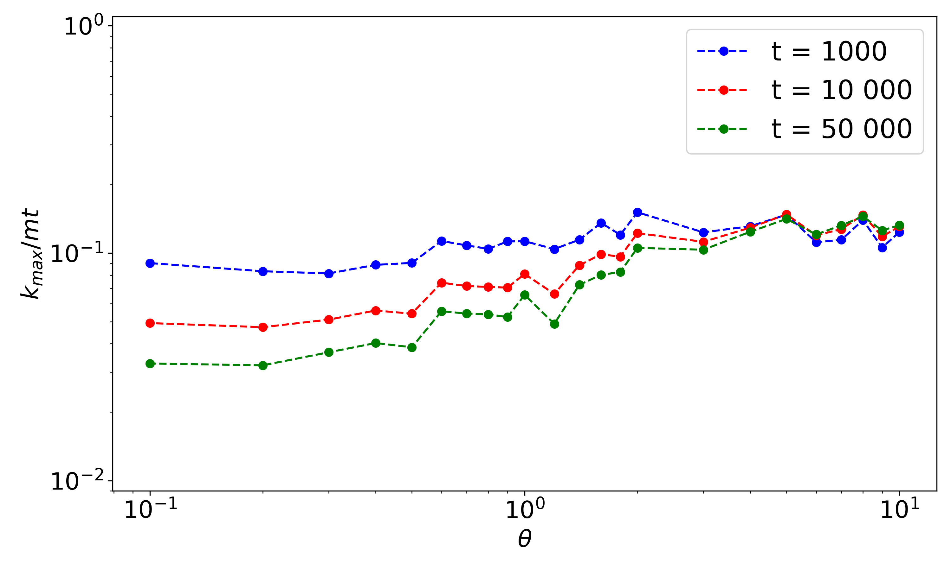
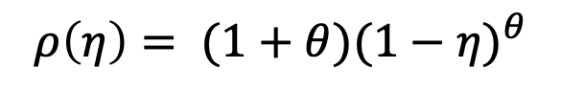
Phase transition: Bose-Einstein condensation
$$ρ\left(η\right)= (1+θ){(1−η)}^{θ}$$

Slide 10
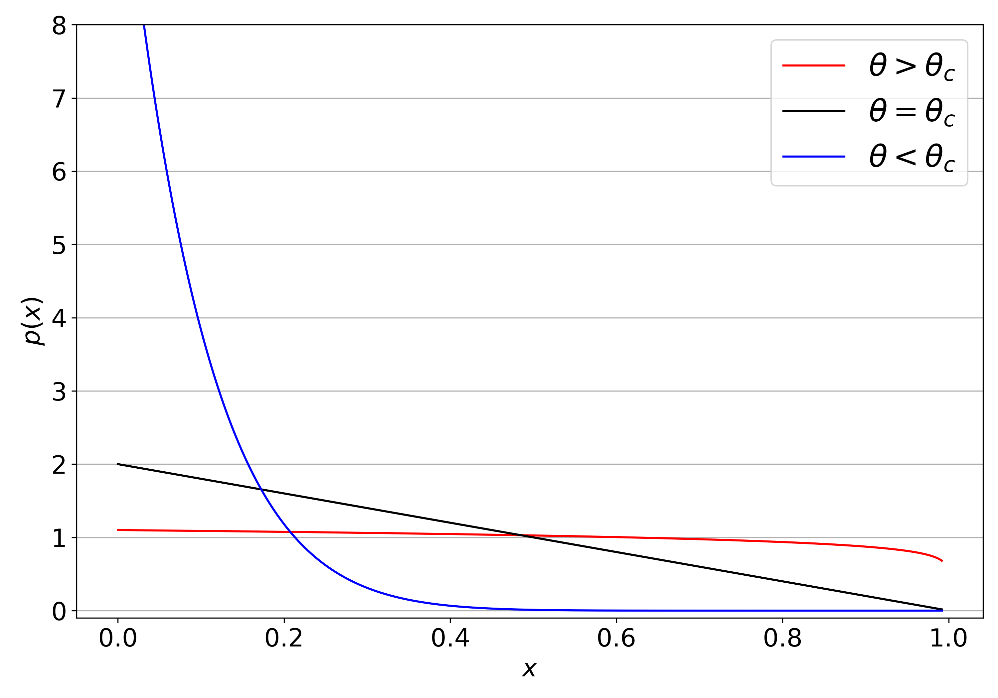
Phase transition: Bose-Einstein condensation

